Slide 1

AASD 4004
Machine Learning - II
Applied AI Solutions Developer Program

Slide 2
Module 10 Image Transformations Image Histograms Image Convolutions
Vejey Gandyer

Slide 3
Agenda
Image Transformations
Image Histograms
Image Convolutions

Slide 4
Image Transformations
What is it?

Slide 5
Image Transformations
Refers to the task of transforming digital images
- Translation
- Rotation
- Resizing

Slide 6
Resizing
When resizing an image, we need to keep in mind the aspect ratio (proportional relationship of width and height of the image)
Computing the ratio
Divide the new width by old width of the image
Computing the dimensions
Multiply the old height by ratio r and convert it to an integer
resize( )

Slide 7
Translation
Translation is the shifting of an image along the x and y axis.
Using translation, we can shift an image up, down, left, or right, along with any combination of the above!
NOTE: Translating (shifting) an image is given by a NumPy matrix in the form: [[1, 0, shiftX], [0, 1, shiftY]]
You simply need to specify how many pixels you want to shift the image in the X and Y direction.

Slide 8
Translation Matrix
Translation matrix M is defined as a floating point array
The first row of the matrix is [1, 0, t_{x}], where t_{x} is the number of pixels we will shift the image left or right.
Negative values of t_{x} will shift the image to the left
Positive values of t_{x} will shift the image to the right
The second row of the matrix is [0, 1, t_{y} ], where t_{y} is the number of pixels we will shift the image up or down.
Negative value of t_{y} will shift the image up
Positive values of t_{y} will shift the image down

Slide 9
warpAffine( )
The first argument is the image we wish to shift
Second argument is our translation matrix M
Third argument is the dimensions (width and height) of our image

Slide 10
Rotation
Rotation is rotating an image by some angle θ
θ to represent by how many degrees to rotate the image
When we rotate an image, we need to specify around which point we want to rotate, mostly rotate around the center of an image; you can rotate around any arbitrary point.
Steps
1. Find the center of the image
2. Rotation Matrix R
3. Rotate the image

Slide 11
Rotation Matrix
Rotation matrix R is computed using getRotationMatrix2D
getRotationMatrix2D function takes three arguments
the point at which we want to rotate the image around
θ, the number of degrees we are going to rotate the image
Scale of the image
1.0 --> No change in dimensions
2.0 --> Double the size
0.5 --> Half the size

Slide 12
warpAffine( )
The first argument is the image we wish to rotate
Second argument is our Rotation matrix R
Third argument is the dimensions (width and height) of our image

Slide 13
Image Histograms
What is it?

Slide 14
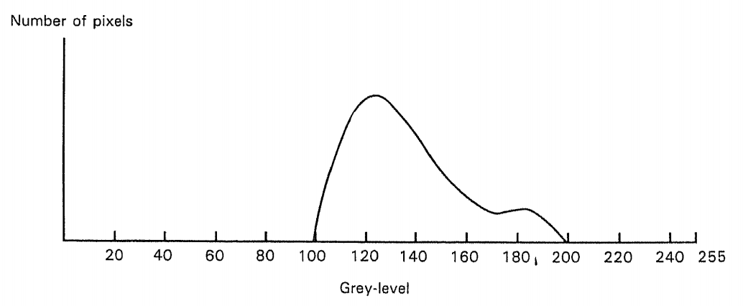
Image Histogram
Distribution of pixel intensities of an image (# pixels Vs Pixel Intensities)
- Grayscale histogram
- Color histogram

Slide 15
Image Histogram
When plotting the histogram, the X-axis serves as our bins
- If we construct a histogram with 256 bins, then we are effectively counting the number of times each pixel value occurs
- If we use only 2 (equally spaced) bins, then we are counting the number of times a pixel is in the range [0, 128] or [128, 255]
The number of pixels binned to the x-axis value is then plotted on the y-axis

Slide 16
calcHist( )
images: This is the image that we want to compute a histogram for
Wrap it as a list: [myImage]
channels: This is a list of indexes, where we specify the index of the channel we want to compute a histogram for
Grayscale image, the list would be [0].
RGB image,, the channels list would be [0,1,2]
mask:
If a mask is provided, a histogram will be computed for masked pixels only
If we do not have a mask, we can just provide a value of None
histSize: This is the number of bins we want to use when computing a histogram Again, this is a list, one for each channel we are computing a histogram for. The bin sizes do not all have to be the same. Here is an example of 32 bins for each channel: [32,32,32]
ranges: range of possible pixel values.
[0, 256] for each channel

Slide 17
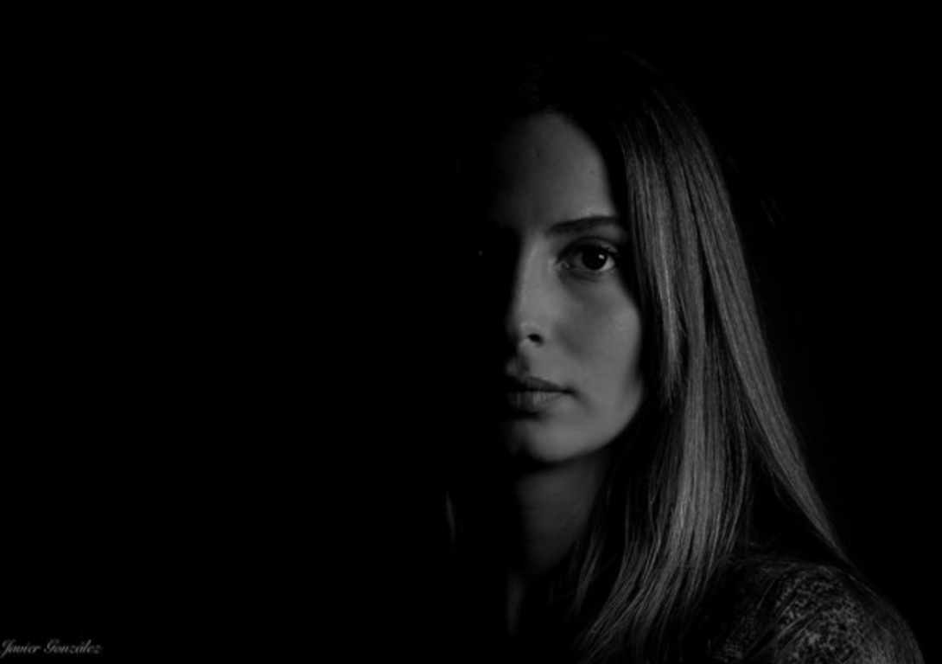
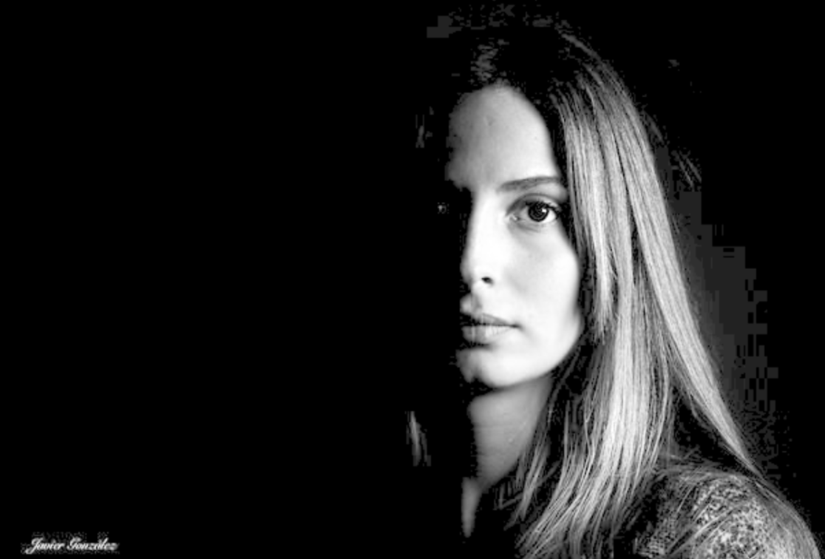
Low-contrast images

Slide 18
Histogram Equalization
Histogram equalization improves the contrast of an image by “stretching” the distribution of pixels
Consider a histogram with a large peak at the center of it. Applying histogram equalization will stretch the peak out towards the corner of the image, thus improving the global contrast of the image.
Histogram equalization is applied to grayscale images
Useful when an image contains foregrounds and backgrounds that are both dark or both light
- It tends to produce unrealistic effects in photographs
- Normally useful when enhancing the contrast of medical or satellite images

Slide 19
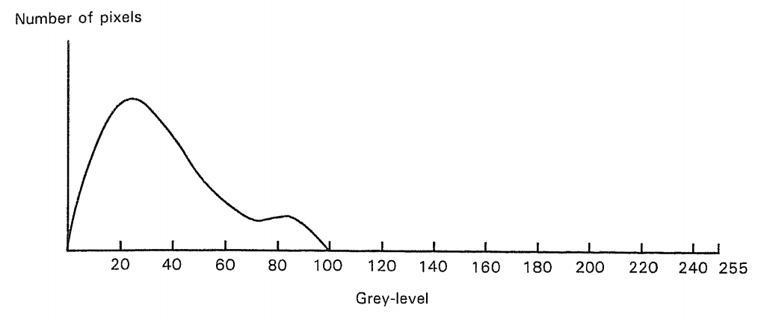
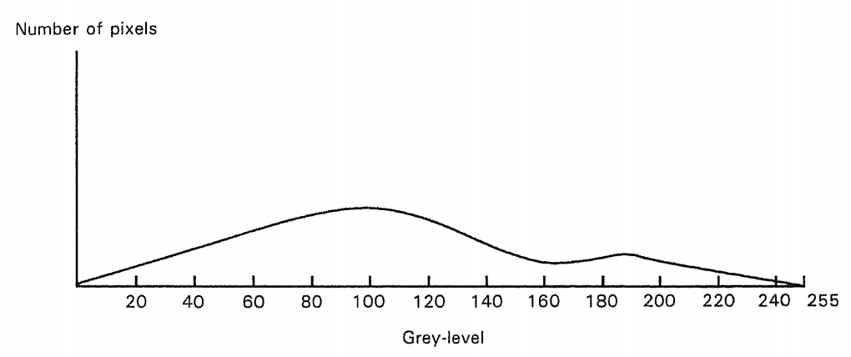
Histogram Equalization

Slide 20
Image Convolutions
What is it?

Slide 21
Convolution
Convolution is element-wise multiplication of two matrices followed by a sum
- Take two matrices
- Multiply them element-by-element (not a dot product)
- Sum the elements together
Uses
- Blurring
- Edge Detection
- Convolutional Neural Network (CNN) **
** DL- I

Slide 22
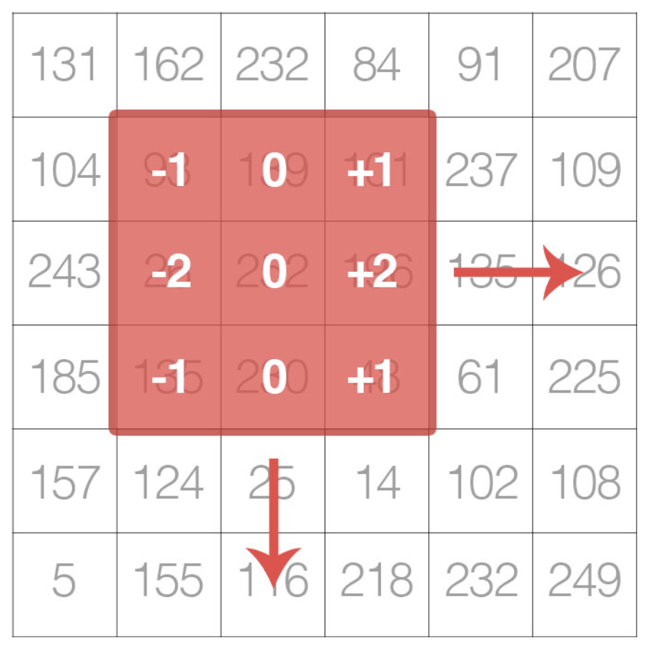
Convolution
Image ( White Background )
Kernel (Orange matrix)
Move the kernel from top-left of the image and move around from left to right and top to down

Slide 23
Convolution Steps
Select an (x, y)-coordinate from the original image
Place the center of the kernel at this (x, y)-coordinate
Take the element-wise multiplication of the input image region and the kernel, then sum up the values of these multiplication operations into a single value. The sum of these multiplications - kernel output
Use the same (x, y)-coordinates from Step #1, but this time, store the kernel output in the same (x, y)-location as the output image

Slide 24
Further Reading
Digital Image Processing 4th edition
Rafael Gonzalez & Richard Woods

